Slide 1





Smart Click
Multi-Location Wireless Light Switch

Slide 2
Product backlog
Priority
ID | User Story | Estimation | Priority
2 | As a Product Owner I want the switch device to receives signal and turn on/off the light | 2 weeks | 1
1 | As an User I want my application to control the light switch | 2 weeks | 2
4 | As an User I want my application to automatically connect to Bluetooth | 2 weeks | 3
5 | As an User I want to schedule light live-time | 2 weeks | 4
3 | As an User I want swipe the control button on my application | 2 weeks | 5
High
Low

Slide 3
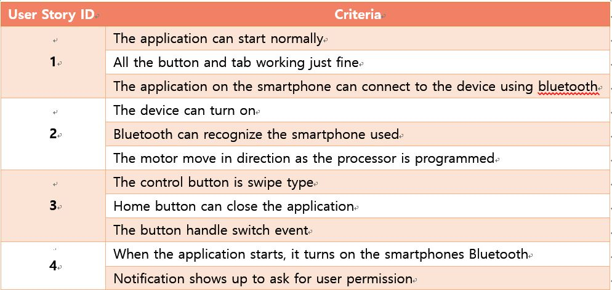
Acceptance Criteria
As an User I want my application to control the light switch
As a Product Owner I want the switch device to receives signal and turn on/off the light
As an User I want swipe the control button on my application
As an User I want my application to automatically connect to Bluetooth

Slide 4
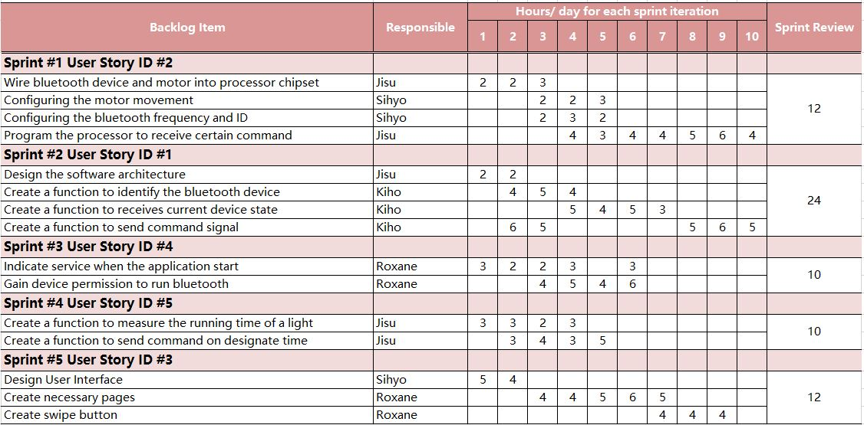
Sprint Backlog
As an User I want swipe the control button on my application
As an User I want my application to control the light switch
As an User I want my application to automatically connect to Bluetooth
As an User I want to schedule light live-time
As an User I want swipe the control button on my application

Slide 5
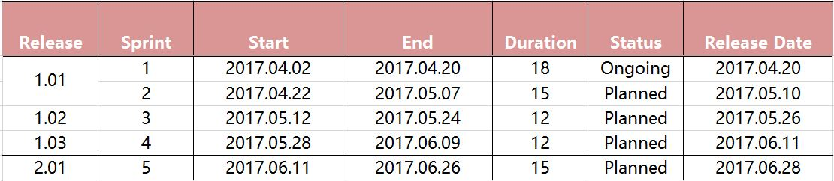
Release Plan

Slide 6
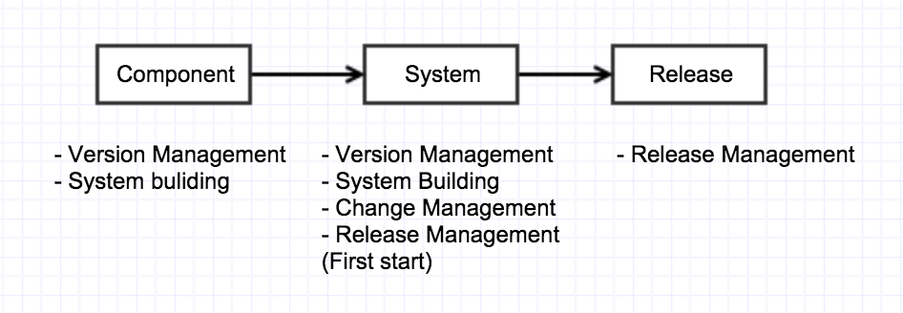
Configuration management
Configuration Management Process
Notes:
Version Management :
When independent development management not overlap each other.
Change Management :
Tracking the changing requirements Management

Slide 7
Configuration Item
 | Configuration Item | Note
1 | Project plan | Planning
2 | Configuration Management document | Planning
3 | Changing Management document | Planning
4 | Requirements definition document | Planning
5 | Design definition document | Design
6 | Source Code definition document | Development
7 | Design guide | Design
8 | Coding guide | Development
9 | Testing document | Planning /Development
10 | User manual | Planning
Notes:
We conducted five Planning part, 2 of Design part, 3 Development of the project and consists of a total of 10 Software Configuration item. This plan was carried out systematically by 10 Software Configuration item Configuration.

Slide 8


Repository library
Notes:
We used git, SourceTree Software.

Slide 9
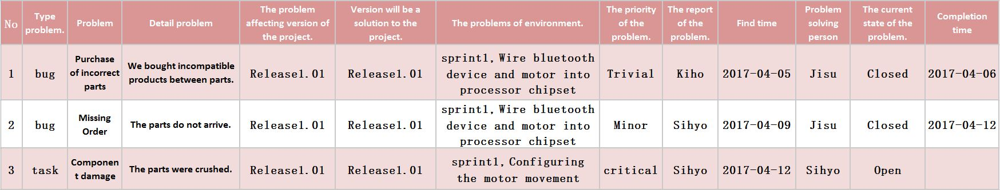
Defects Management

Slide 10


